Slide 1
Riley Arnold
Final Presentation

Slide 2
What I learned
Scrum ideology and Agile environments
Managing Project Execution using Workfront
Adjusting project timelines according to priorities
Routing jobs to Stakeholders, Legal, and IP for approval/feedback
Reviewing/providing feedback on comps
Participating in agile ceremonies such as Standup & Retro
Communicating with Partners

Slide 3
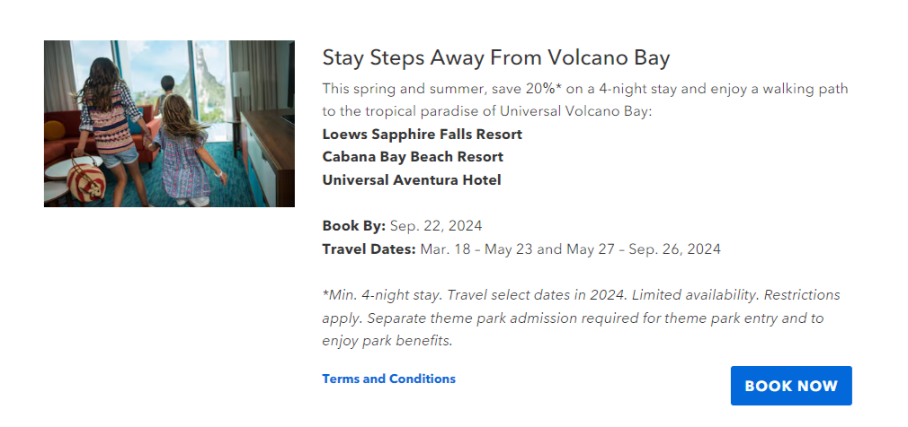
Notes:
Hotel Offer Jobs
VB Walking Path jobs
- 1 Hotel Offer Page Module
- 1 Component on the Deals and Specials Article list
668 Portifino Bay jobs
- 1 Hotel Offer Page Module
- 1 Component on the Deals and Specials Article list
Also Shadowed Sergio and Erin on some jobs
& helped preflight
Worked on SOPs for Yoshi’s Island

Slide 4
DDM Onboarding Planner

Slide 5
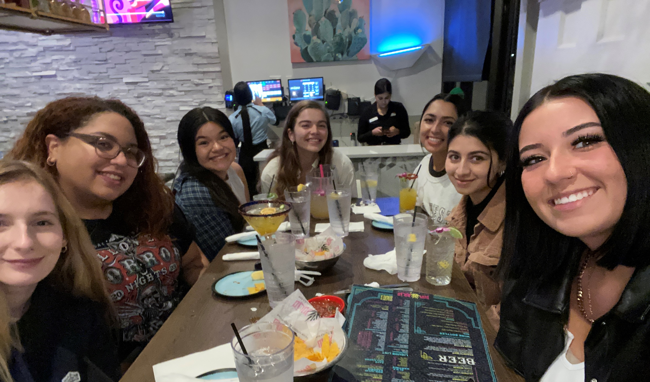
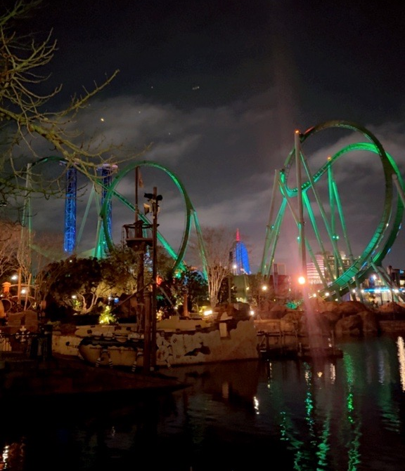
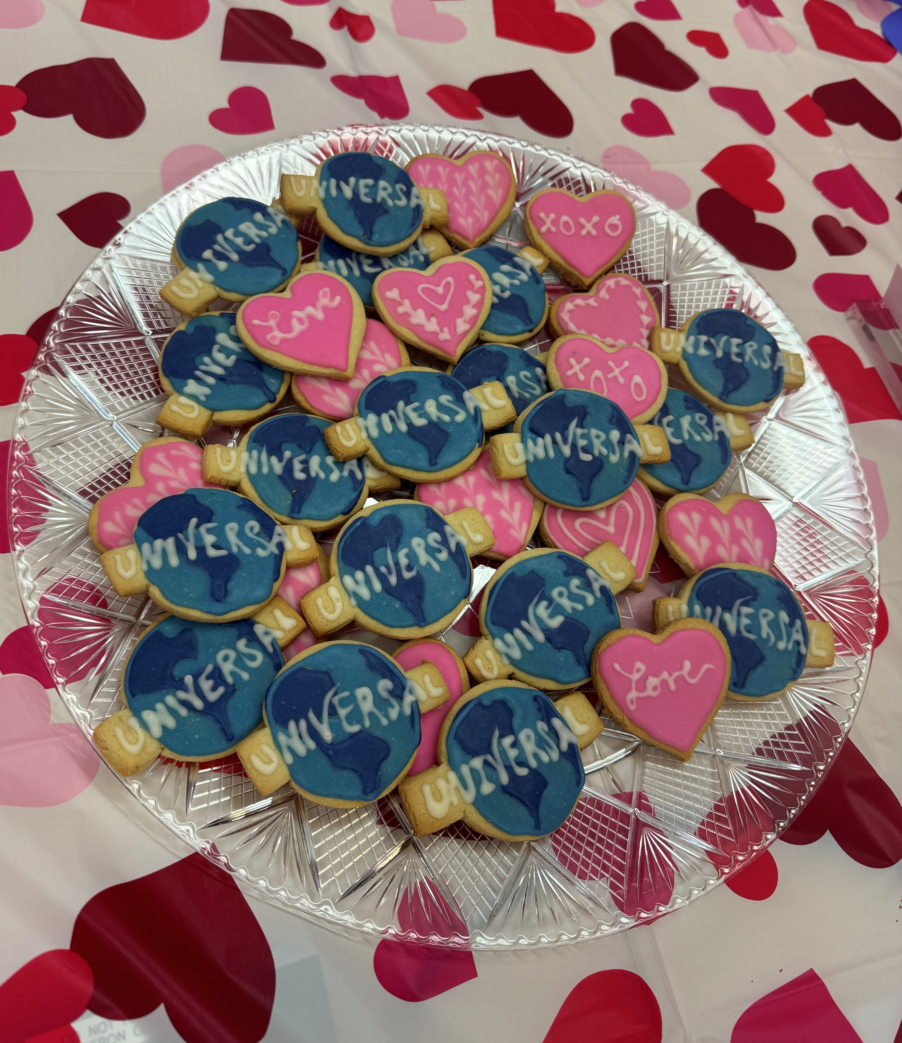
Internship Impact
Learned how to manage digital projects in an agile environment
Made long-lasting connections and friendships
Learned what it takes to implement a campaign component from start to finish
Attended awesome team events
Learned more about my career goals and interests
Notes:
Set the bar high with Universal

Slide 6
Thank You!

